Slide 1

Modeling, Measuring, and Limiting Adversary Knowledge
Piotr (Peter) Mardziel

Slide 2
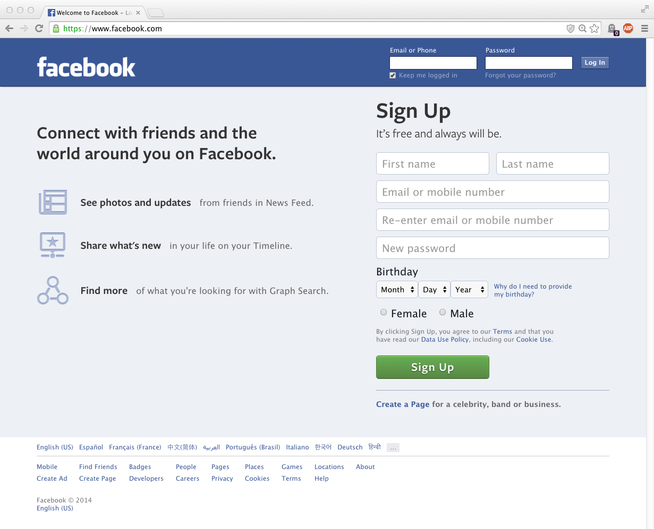

Slide 4
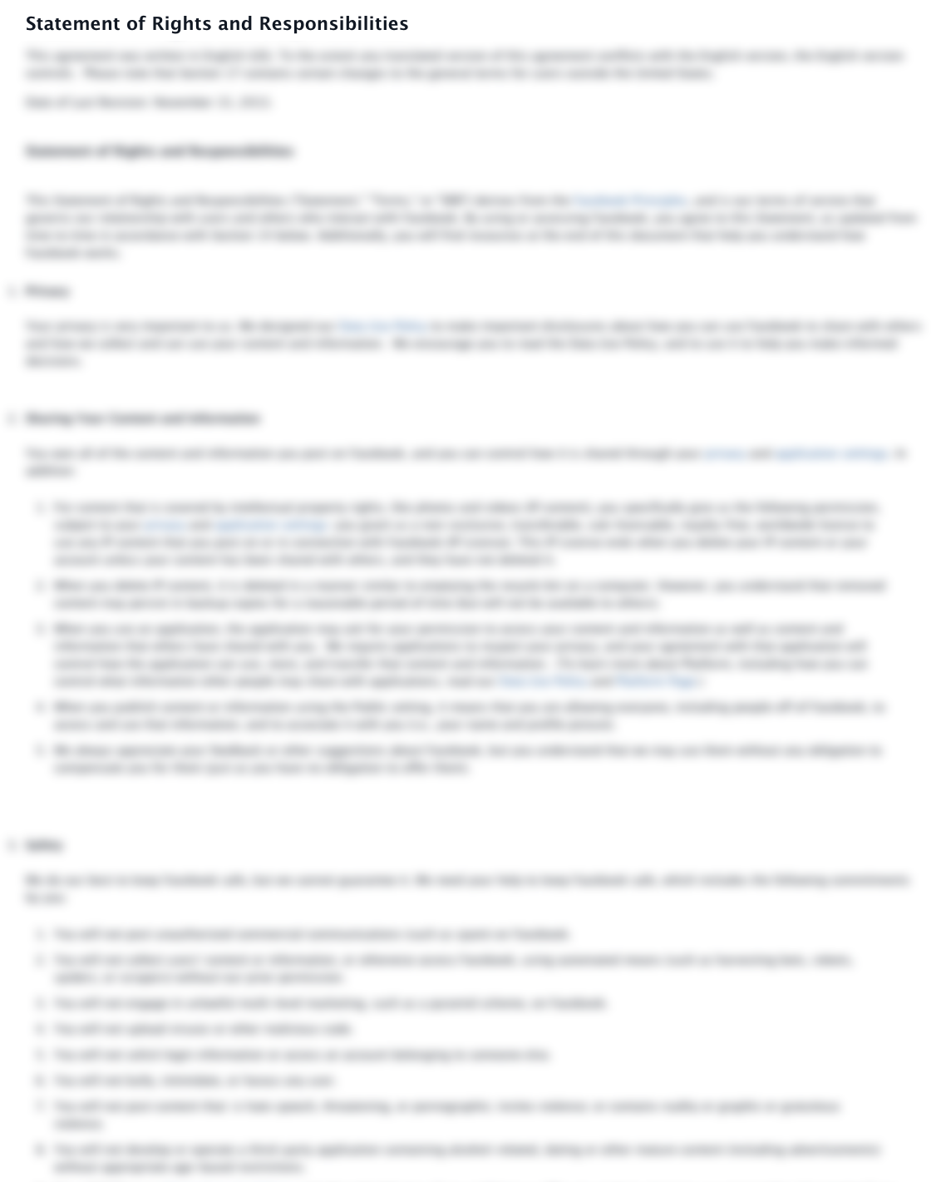
WE OWN YOU

Slide 5
WE OWN YOUR DATA

Slide 6

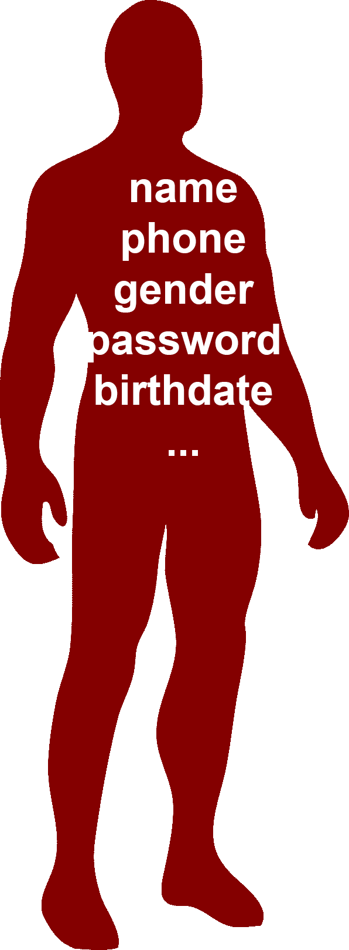

Slide 7
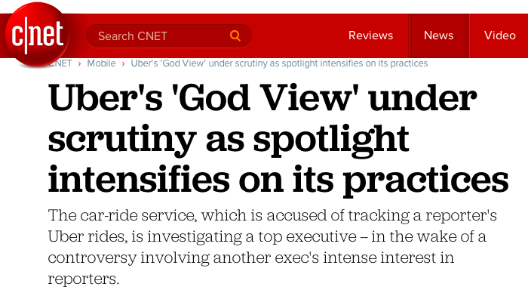
“If you’re not paying, you’re the product.”

Slide 8


Slide 9
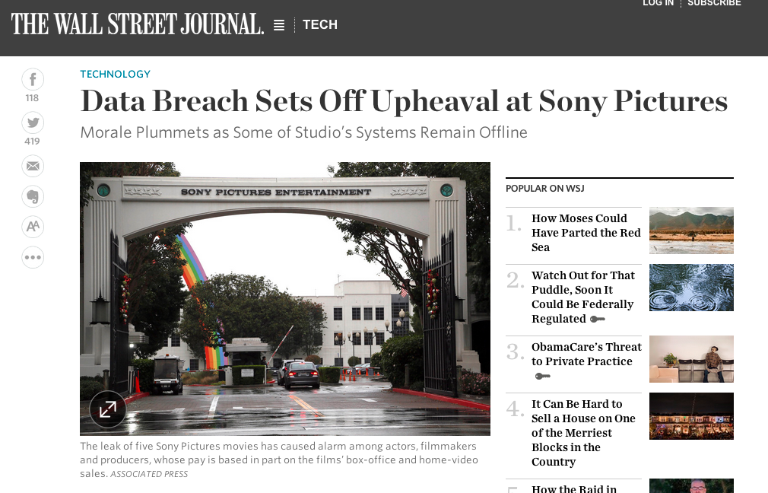

Slide 10

data misuse
(intentional or unintentional)

Slide 11
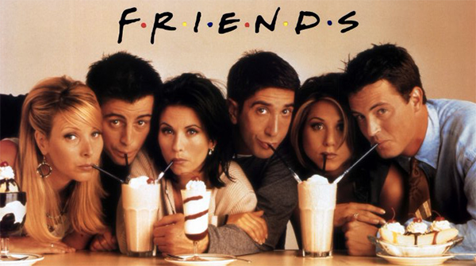

Alternative?
Notes:
Todo: label: alternative

Slide 12
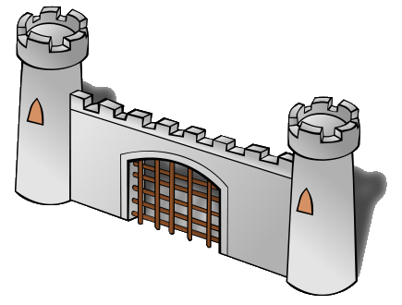
Alternative:
Query interface under your control

Slide 13
Which one of us is oldest?
What is your name, birthdate, gender?
Alternative:
Query interface under your control
Is your birthday within the next week?

Slide 14
Which one of us is oldest?
What is your name, birthdate, gender?
Support collaborative queries
REJECT risky requests
Alternative:
Query interface under your control
Is your birthday within the next week?
Answer benign requests

Slide 15
Which one of us is oldest?
What is your name, birthdate, gender?
???
???
Alternative:
Query interface under your control
Is your birthday within the next week?
???
Need:
Means to distinguish benign requests from malicious ones.

Slide 16
What is your name, birthdate, gender?
Risk
Here you go …

Slide 17
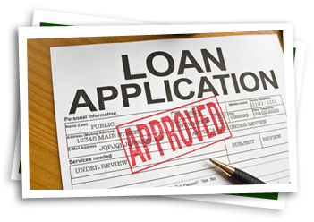
What is your name, birthdate, gender?
Risk
Likelihood of bad outcome
Here you go …

Slide 18
What is your name, birthdate, gender?
Risk
Likelihood of bad outcome
This talk:
adversary guesses secret
“vulnerability”
Here you go …

Slide 19
Risk depends on what has already been revealed.
Is your birthday within the next week?

Slide 20
Risk depends on what has already been revealed.
Yesterday: Is your birthday within the next week?
No
Is your birthday within the next week?

Slide 21
Modeling, Measuring, and Limiting Adversary Knowledge
Model adversary knowledge
Integrate prior answers
Measure risk of bad outcome
Vulnerability: probability of guessing
Limit risk
Reject questions with high resulting risk

Slide 22
Wider Applicability

Slide 23





Slide 24
Confidentiality can be enforced by deciding whether to share based on evolving models of adversary knowledge.
Notes:
TODO: insert thesis

Slide 25
Modeling, Measuring, and Limiting Adversary Knowledge
[CSF11,JCS13]
Limit risk and computational aspects of approach
[PLAS12]
Limit risk for collaborative queries
[S&P14,FCS14]
Measure risk when secrets change over time

Slide 26
Modeling, Measuring, and Limiting Adversary Knowledge
[CSF11,JCS13]
Limit risk and computational aspects of approach
[PLAS12]
Limit risk for collaborative queries
[S&P14,FCS14]
Measure risk when secrets change over time

Slide 27

Model/Measure/Limit

Slide 28

Model
Prior/Background Knowledge

Slide 29
Model
If I answer Q1
Prior/Background Knowledge
If I don’t answer

Slide 30
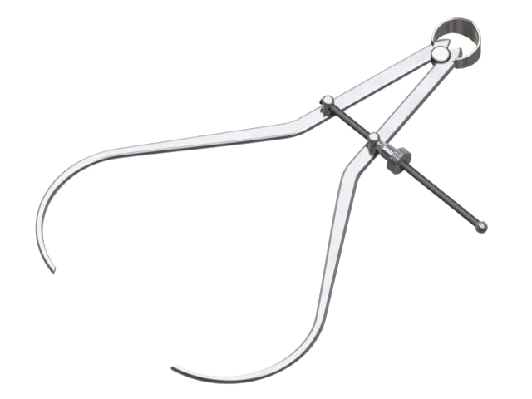
Measure
Tolerable risk
If I answer Q1
Prior/Background Knowledge
If I don’t answer

Slide 31
Model
Prior/Background Knowledge
I answered Q1

Slide 32
Measure
Intolerable risk
If I answer Q2
Prior/Background Knowledge
I answered Q1
If I don’t answer

Slide 33
Limit
Intolerable risk
If I answer Q2
Prior/Background Knowledge
I answered Q1
If I don’t answer

Slide 34
Model
Prior/Background Knowledge
I answered Q1
I rejected Q2

Slide 35
Example: Birthday
Is your birthday within the next week?
?

Slide 36
Example: Birthday
bool Q1(int bday) {
return (bday ≥ 270 and
bday < 270+7)
}
?
Notes:
Todo: emphasize important and diminish unimportant

Slide 37
Modeling knowledge
Prior knowledge: a probability distribution
Pr[bday = x] = 1/365 for 1 ≤ x ≤ 365

Slide 38
Example: Birthday
bool Q1(int bday) {
return (bday ≥ 270 and
bday < 270+7)
}
true
bday=270
Notes:
Todo: emphasize important and diminish unimportant

Slide 39
Modeling knowledge
Prior knowledge:
Pr[bday=x] = 1/365 for 1 ≤ x ≤ 365
Posterior knowledge given Q1(bday) = true
Pr[bday=x | true] = 1/7 for 270 ≤ x ≤ 276
Elementary* probability
*If you have Pr[Q1(X) | X] and Pr[Q1(bday)]
Notes:
Todo: mention probabilistic computation and Q1 is a general program

Slide 40
Measure risk
Risk* = probability of most probable value
Prior knowledge:
Pr[bday=x] = 1/365 for 1 ≤ x ≤ 365
Risk: 1/365 probability of guessing bday
Posterior knowledge given Q1(bday) = true
Pr[bday=x | true] = 1/7 for 270 ≤ x ≤ 276
Risk: 1/7 probability of guessing bday
* details

Slide 41
Limit via Risk Threshold
Answer if risk ≤ t

Slide 42
Limit via Risk Threshold
Answer if risk ≤ t
How to pick threshold t? What is tolerable?
Notes:
Todo: emphasize limit risk , add slide for this

Slide 43
Vulnerability
Vulnerability = V
Incur loss of $L if your secret is guessed
Expected loss = $V*L
* details

Slide 44
Example: Birthday
If I answer Q1, the adversary will have 1/7 probability of guessing my bday.
Assume risk ≤ 1/2 is tolerable.

Slide 45
Example: Birthday
bool Q1(int bday) {
return (bday ≥ 270 and
bday < 270+7)
}
true
bday=270
Notes:
Todo: emphasize important and diminish unimportant

Slide 46
Birthday: next day
bool Q1(int bday) {
return (bday ≥ 270 and
bday < 270+7)
}
bool Q2(int bday) {
return (bday ≥ 271 and
bday < 271+7)
}
true
false?
bday=270
Notes:
Todo: emphasize important and diminish unimportant

Slide 47
Measure risk
Prior knowledge (given Q1)
Pr[bday=x | true] = 1/7 for 270 ≤ x ≤ 276
Risk: 1/7 probability of guessing bday
Posterior knowledge (given Q1,Q2)
Pr[bday=x | true,false] = 1 when x = 270
Risk: 100% chance of guessing bday

Slide 48
Limit risk
If I answer Q2, the adversary will have 100% chance of guessing my bday.
Not tolerable.
So, reject Q2?

Slide 49
Birthday: next day
bool Q1(int bday) {
return (bday ≥ 270 and
bday < 270+7)
}
bool Q2(int bday) {
return (bday ≥ 271 and
bday < 271+7)
}
true
Reject
bday=270
Notes:
Todo: emphasize important and diminish unimportant

Slide 50
Birthday: next day (Alternate Reality)
bool Q1(int bday) {
return (bday ≥ 270 and
bday < 270+7)
}
bool Q2(int bday) {
return (bday ≥ 271 and
bday < 271+7)
}
true
true
bday=271
Notes:
Todo: emphasize important and diminish unimportant

Slide 51
Birthday: next day (Alternate Reality)
bool Q1(int bday) {
return (bday ≥ 270 and
bday < 270+7)
}
bool Q2(int bday) {
return (bday ≥ 271 and
bday < 271+7)
}
true
true
271≤bday≤276
Notes:
Todo: emphasize important and diminish unimportant

Slide 52
Measure risk
Assuming adversary knows Alice’s tolerable threshold: ½ (or anything < 1)
Output true implies 271 ≤ bday ≤ 276
Reject implies bday = 270
Notes:
TODO: write this in prose

Slide 53
Recall: Model
If I answer Q1
Prior/Background Knowledge
If I don’t answer

Slide 54
Measure risk
Problem: risk measurement depends on the value of the secret

Slide 55
Recall: Model
If I answer Q1 with Q1(bday)
Prior/Background Knowledge
If I don’t answer

Slide 56
Measure risk
Problem: risk measurement depends on the value of the secret
Solution: limit risk over all possible outputs (that are consistent with adversary’s knowledge)
“worst-case vulnerability”

Slide 57
Worst-case Vulnerability
If I answer Q1 with true
If I answer Q1 with false
✔
Prior/Background Knowledge
If I don’t answer

Slide 58
Implementation
Probabilistic programming:
Given Pr[bday], program Q1
Compute Pr[bday | Q1(bday) = yes]
Problem: undecidable/intractable when possible

Slide 59
Implementation
Probabilistic programming:
Given Pr[bday], program Q1
Compute Pr[bday | Q1(bday) = yes]
Problem: undecidable/intractable when possible
Solution: sound approximation

Slide 60
Geometric probability approximation
Prior knowledge:
Pr[bday=x] = 1/365 for 1 ≤ x ≤ 365
Pr[bday=x]
1/365
[
]
1
365
x

Slide 61
Geometric probability approximation
Posterior given Q1(bday) = false:
Pr[bday=x | …] = 1/358
for 1 ≤ x ≤ 269, 277 ≤ x ≤ 365
Pr[bday=x | …]
1/358
[
]
[
]
1
269
277
365
x

Slide 62
Geometric probability approximation
Probability distribution abstraction:
Sum of convex regions with probability bounds.
Pr[bday=x | …]
← For vulnerability
1/358
← For sound inference
[
]
[
]
1
269
277
365
P1
x
P2

Slide 63
Geometric probability approximation
Probability distribution abstraction:
Can represent distributions over large state spaces efficiently
Notes:
Todo: maybe include enumeration vs. abstraction

Slide 64
Modeling, Measuring, and Limiting Adversary Knowledge
[CSF11,JCS13]
Limit risk and computational aspects of approach
“Simulatable” enforcement of risk limit
Probabilistic abstract interpreter based on, intervals, octagons, and polyhedra
Approximation: tradeoff precision and performance
Inference sound relative to vulnerability
Experimental comparison to probabilistic computation via enumeration

Slide 65
Modeling, Measuring, and Limiting Adversary Knowledge
[CSF11,JCS13]
Limit risk and computational aspects of approach
[PLAS12]
Limit risk for collaborative queries
[S&P14,FCS14]
Measure risk when secrets change over time

Slide 66
Modeling, Measuring, and Limiting Adversary Knowledge
[CSF11,JCS13]
Limit risk and computational aspects of approach
[PLAS12]
Limit risk for collaborative queries
[S&P14,FCS14]
Measure risk when secrets change over time

Slide 67
Bob
Which one of us is oldest?
Alice

Slide 68
Bob
bdayB=300
bool Q3(int bdayA, int bdayB) {
return bdayA <= bdayB
}
?
Alice
bdayA=270

Slide 69
Bob
bdayB=???
bool Q3(int bdayA, int bdayB) {
return bdayA <= bdayB
}
?
Alice
bdayA=270

Slide 70
Bob
bdayB=???
bool Q3(int bdayA, int bdayB) {
return bdayA <= bdayB
}
HOW
?
Is this even possible?
Alice
bdayA=270

Slide 71
Collaborative queries
Secure multi-party computation
Parties can compute Q3(bdayA,bdayB) without revealing bdayA/bdayB to each other*
Emulate the trusted 3rd party using cryptographic protocol
Notes:
Todo: add pictures

Slide 72
Collaborative queries
Secure multi-party computation
Parties can compute Q3(bdayA,bdayB) without revealing bdayA/bdayB to each other*
Emulate a trusted 3rd party using cryptographic protocol
* Beyond what is implied by the output

Slide 73
bdayB=300
Bob
bdayB=???
true
true
Trusted
3rd party
bdayA=270
Alice
bdayA=270

Slide 74
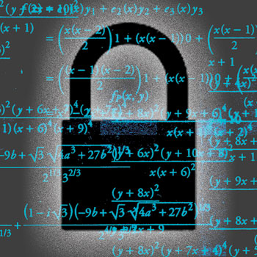
bdayB=300
Bob
bdayB=???
true
true
Trusted
3rd party
bdayA=270
Alice
bdayA=270

Slide 75
Model/Measure/Limit
If I answer Q3 with true
If I answer Q3 with false
Prior/Background Knowledge
If I don’t answer

Slide 76
Modeling knowledge Alice’s Perspective
Bob’s prior knowledge about Alice’s bdayA:
Pr[bdayA=x] = 1/365 for 1 ≤ x ≤ 365

Slide 77
Modeling knowledge
✔
If I answer Q3 with true
If I answer Q3 with false
Prior/Background Knowledge
If I don’t answer

Slide 78
Modeling knowledge
If I answer Q3 with true
If I answer Q3 with false
Prior/Background Knowledge
If I don’t answer

Slide 79
Modeling knowledge
Bob’s prior knowledge about Alice’s bdayA:
Pr[bdayA=x] = 1/365 for 1 ≤ x ≤ 365
Posterior knowledge given Q3(bdayA,bdayB) = true (so bdayA ≤ bdayB)
Pr[bdayA=x | true] = ??? for ???

Slide 80
Modeling knowledge
Problem: Bob’s posterior knowledge about Alice’s data depends on Bob’s secret value

Slide 81
Modeling knowledge
Problem: Bob’s posterior knowledge about Alice’s data depends on Bob’s secret value
If bdayB was 365: Q3(bdayA,bdayB) = true
Pr[bdayA= x | true] = 1/365 for 1 ≤ x ≤ 365
If bdayB was 1: Q3(bdayA,bdayB) = true
Pr[bdayA = x | true] = 1 for x = 1
And anything in between.
Notes:
Todo: better names than bday1,bday2

Slide 82
Modeling knowledge
Problem: Bob’s posterior knowledge about Alice’s data depends on Bob’s secret value
Solution 1: consider all possible values of Bob’s secret:
“worst-worst-case vulnerability”

Slide 83
Worst-case Vulnerability
If I answer Q3 with true
If I answer Q3 with false
Prior/Background Knowledge
If I don’t answer

Slide 84
Worst-Worst-case Vulnerability
When bdayB = 1
If I answer Q3 with true
If I answer Q3 with false
Prior/Background Knowledge
If I don’t answer

Slide 85
Worst-Worst-case Vulnerability
When bdayB = 1
When bdayB = 2
If I answer Q3 with true
If I answer Q3 with true
If I answer Q3 with false
If I answer Q3 with false
Prior/Background Knowledge
If I don’t answer

Slide 86

Extremely Conservative

Slide 87
Modeling knowledge
Problem: Bob’s posterior knowledge about Alice’s data depends on Bob’s secret value
Solution 2: trust the trusted 3rd party to model, measure, and limit risk on your behalf
Trusted 3rd party knows what Bob’s secret value is

Slide 88
bdayB=300
Bob
Trusted 3rd Party
Risk to Alice ≤ tA ?
Risk to Bob ≤ tB ?
bdayB=???
bdayA=270
Alice
bdayA=270

Slide 89
bdayB=300
Bob
Trusted 3rd Party
Risk to Alice ≤ 1/2 ?
Risk to Bob ≤ 1/2 ?
bdayB=???
true
true
bdayA=270
Alice
bdayA=270

Slide 90
bdayB=1
Bob
Trusted 3rd Party
Risk to Alice ≤ 1/2 ?
Risk to Bob ≤ 1/2 ?
bdayB=???
Reject
Reject
Information
Leak
bdayA=270
Alice
bdayA=270

Slide 91
bdayB=1
Bob
Trusted 3rd Party
Risk to Alice ≤ 1/2 ?
Risk to Bob ≤ 1/2 ?
bdayB=???
Reject
true
bdayA=270
Alice
bdayA=270

Slide 92
Modeling, Measuring, and Limiting Adversary Knowledge
[PLAS12]
Limit risk for collaborative queries
Approach 1: Belief sets: tracking possible states of knowledge
Approach 2: Knowledge tracking as secure computation
Simulatable enforcement of risk limit
Experimental comparison of risk measurement for the two approaches.

Slide 93
Modeling, Measuring, and Limiting Adversary Knowledge
[CSF11,JCS13]
Limit risk and computational aspects of approach
[PLAS12]
Limit risk for collaborative queries
[S&P14,FCS14]
Measure risk when secrets change over time

Slide 94
Modeling, Measuring, and Limiting Adversary Knowledge
[CSF11,JCS13]
Limit risk and computational aspects of approach
[PLAS12]
Limit risk for collaborative queries
[S&P14,FCS14]
Measure risk when secrets change over time

Slide 95
Model
Risk (guessing bday)
Risk (guessing bday)
Risk (guessing bday)
Time 0:
Prior knowledge
Time 1:
I answered Q1(bday)
Time 2:
I answered Q2(bday)

Slide 96
Secrets Change
Risk (guessing loc0)
Risk (guessing loc0)
Risk (guessing loc0)
Time 0:
Prior knowledge
Time 1:
I answered Q1(loc1)
Time 2:
I answered Q2(loc2)

Slide 97
Secrets Change: Moving Target
Risk (guessing loc0)
Risk (guessing loc1)
Risk (guessing loc2)
Time 0:
Prior knowledge
Time 1:
I answered Q1(loc1)
Time 2:
I answered Q2(loc2)

Slide 98

Decreasing Risk
Notes:
Todo: generate better figure

Slide 99
Correlation
Risk (guessing loc0)
Risk (guessing loc1)
Risk (guessing loc2)
Time 0:
Prior knowledge
Time 1:
I rejected Q1(loc1)
Time 2:
I rejected Q2(loc2)
Ticket receipt for DCA→HNL for Friday December 12 at 4pm.

Slide 100
Prediction
Risk (guessing loc0)
Expected Risk (guessing loc1)
Expected Risk (guessing loc2)
Time 0:
Prior knowledge
Time 1:
I rejected Q1(loc1)
Time 2:
I rejected Q2(loc2)
Future
Present

Slide 101
Model for Dynamic Secrets
Risk (guessing loc0)
Expected Risk (guessing loc1)*
Expected Risk (guessing loc2)*
Time 0:
Prior knowledge (loc0)
Prior knowledge (Δ)
Time 1:
I answered Q*(loc1)
Time 2:
I answered Q*(loc2)
Future
Present

Slide 102
Model for Dynamic Secrets
Risk (guessing loc0)
Expected Risk (guessing loc1)*
Expected Risk (guessing loc2)*
Time 0:
Prior knowledge (loc0)
Prior knowledge (Δ)
Time 1:
I answered Q*(loc1)
Time 2:
I answered Q*(loc2)
* Optimal adversary behavior
Future
Present

Slide 103
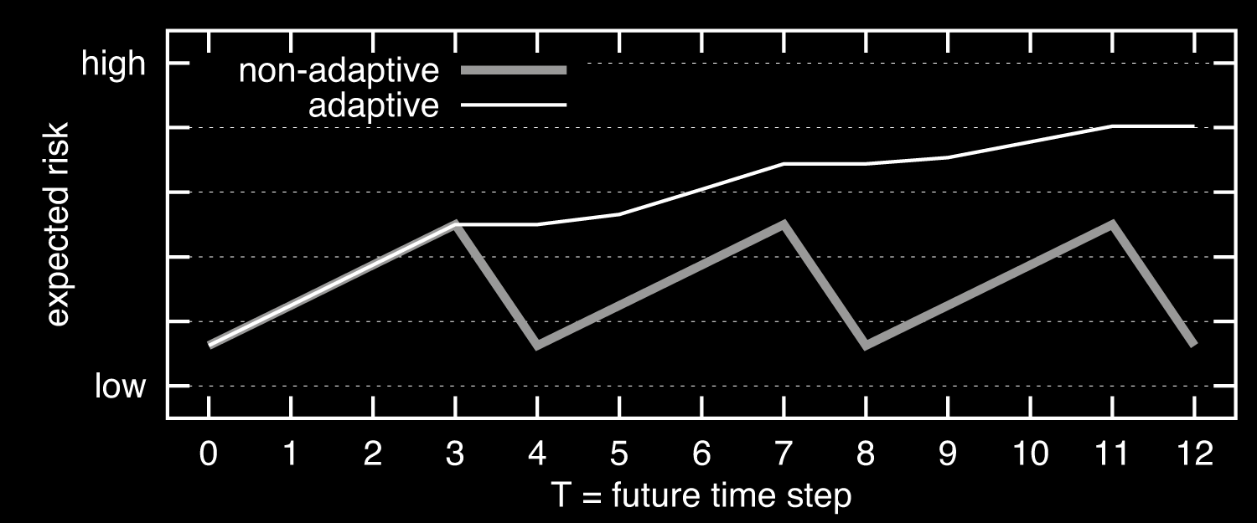
Monotonic Risk
Notes:
Todo: generate better figure

Slide 104
Tradeoff
Hide locT or hide Δ
A more frequently changing secret can result in higher risk in some cases

Slide 105
Modeling, Measuring, and Limiting Adversary Knowledge
[S&P14,FCS14]
Measure risk when secrets change over time
Model of risk with dynamic secrets and adaptive adversaries
Model separating risk to user from gain of adversary
Extension of information flow metrics
Implementation and experimentation

Slide 106
Modeling, Measuring, and Limiting Adversary Knowledge
[CSF11,JCS13]
Limit risk and computational aspects of approach
[PLAS12]
Limit risk for collaborative queries
[S&P14,FCS14]
Measure risk when secrets change over time

Slide 107
Future
Probabilistic computation
Make go fast(er)
Secure multi-party computation
Make go fast(er)
Changing secrets
Characterize/avoid pathological cases

Slide 108
Sharing on Your Own Terms

